Slide 1
DNA PATTERN MATCHING
ANG SHU HUI
BACHHAS NIKITA
-GROUP 1-
CZ2001 Algorithm Project 1
KUNDU KOUSHANI
LEONARDO IRVIN PRATAMA

Slide 2
Table of Contents
Finite Automata
Boyer-Moore Horspool
Comparison to Brute Force
Algorithm #1
Algorithm #2
How is each algorithm better than the Naïve algorithm?
Comparisons to Other Algorithms
Final Judgement
Why we chose FA and Boyer-Moore Horspool over other algorithms?
In which condition is each algorithm suitable for?
Notes:
Hey guys is this okay:
Introduction + Finite Automata: Irvin
Boyer-Moore Horspool: Shu Hui
Comparison to Brute Force: Koushani
Comparisons to Other Algorithms + ending: Nikta

Slide 3


FINITE AUTOMATA

Slide 4
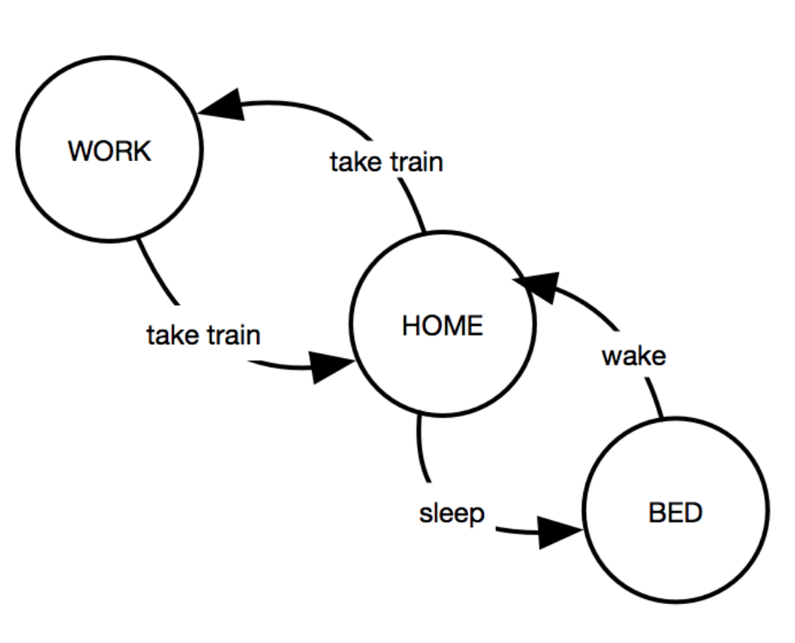
Finite Automata
Finite Automata uses the concept of state machine to assign states on every letter in the main sequence.
Remember Digital Logic (CZ1005)?

Slide 5
Pre-processing Stage (ACACG)
 | A | C | T | G
0
1
2
3
4
5
A C A C G

Slide 6

Pre-processing Stage (ACACG)
 | A | C | T | G
0 | 1
1 |  | 2
2 | 3
3 |  | 4
4 |  |  |  | 5
5
0
1
2
3
4
5
A C A C G

Slide 7
Pre-processing Stage (ACACG)
In this case, the AC may become the start of another sequence
 | A | C | T | G
0 | 1
1 |  | 2
2 | 3
3 |  | 4
4 | 3 |  |  | 5
5
A C A C A C G
A C A C G

Slide 8
Pre-processing Stage (ACACG)
 | A | C | T | G
0 | 1
1 | 1 | 2
2 | 3
3 | 1 | 4
4 | 3 |  |  | 5
5 | 1
A C A C G

Slide 9
Pre-processing Stage (ACACG)
 | A | C | T | G
0 | 1 | 0 | 0 | 0
1 | 1 | 2 | 0 | 0
2 | 3 | 0 | 0 | 0
3 | 1 | 4 | 0 | 0
4 | 3 | 0 | 0 | 5
5 | 1 | 0 | 0 | 0
The rest is filled with 0 as it means that the character
could not be a pattern of the substring.
A C A C G

Slide 10
Searching Stage
0
A C A C A C G
 | A | C | T | G
0 | 1 | 0 | 0 | 0
1 | 1 | 2 | 0 | 0
2 | 3 | 0 | 0 | 0
3 | 1 | 4 | 0 | 0
4 | 3 | 0 | 0 | 5
5 | 1 | 0 | 0 | 0
A C A C G

Slide 11
Searching Stage
1
A C A C A C G
 | A | C | T | G
0 | 1 | 0 | 0 | 0
1 | 1 | 2 | 0 | 0
2 | 3 | 0 | 0 | 0
3 | 1 | 4 | 0 | 0
4 | 3 | 0 | 0 | 5
5 | 1 | 0 | 0 | 0
A C A C G

Slide 12
Searching Stage
2
A C A C A C G
 | A | C | T | G
0 | 1 | 0 | 0 | 0
1 | 1 | 2 | 0 | 0
2 | 3 | 0 | 0 | 0
3 | 1 | 4 | 0 | 0
4 | 3 | 0 | 0 | 5
5 | 1 | 0 | 0 | 0
A C A C G

Slide 13
Searching Stage
3
A C A C A C G
 | A | C | T | G
0 | 1 | 0 | 0 | 0
1 | 1 | 2 | 0 | 0
2 | 3 | 0 | 0 | 0
3 | 1 | 4 | 0 | 0
4 | 3 | 0 | 0 | 5
5 | 1 | 0 | 0 | 0
A C A C G

Slide 14
Searching Stage
4
A C A C A C G
 | A | C | T | G
0 | 1 | 0 | 0 | 0
1 | 1 | 2 | 0 | 0
2 | 3 | 0 | 0 | 0
3 | 1 | 4 | 0 | 0
4 | 3 | 0 | 0 | 5
5 | 1 | 0 | 0 | 0
A C A C G

Slide 15
Searching Stage
5
A C A C A C G
 | A | C | T | G
0 | 1 | 0 | 0 | 0
1 | 1 | 2 | 0 | 0
2 | 3 | 0 | 0 | 0
3 | 1 | 4 | 0 | 0
4 | 3 | 0 | 0 | 5
5 | 1 | 0 | 0 | 0
A C A C G

Slide 16
Searching Stage
3
A C A C A C G
 | A | C | T | G
0 | 1 | 0 | 0 | 0
1 | 1 | 2 | 0 | 0
2 | 3 | 0 | 0 | 0
3 | 1 | 4 | 0 | 0
4 | 3 | 0 | 0 | 5
5 | 1 | 0 | 0 | 0
A C A C G

Slide 17
Searching Stage
4
A C A C A C G
 | A | C | T | G
0 | 1 | 0 | 0 | 0
1 | 1 | 2 | 0 | 0
2 | 3 | 0 | 0 | 0
3 | 1 | 4 | 0 | 0
4 | 3 | 0 | 0 | 5
5 | 1 | 0 | 0 | 0
A C A C G

Slide 18
Searching Stage
5
A C A C A C G
 | A | C | T | G
0 | 1 | 0 | 0 | 0
1 | 1 | 2 | 0 | 0
2 | 3 | 0 | 0 | 0
3 | 1 | 4 | 0 | 0
4 | 3 | 0 | 0 | 5
5 | 1 | 0 | 0 | 0
A C A C G
An occurrence of substring is found at index 2.

Slide 19

Cases
No matter what still needs to
Iterate through all possible combinations while pre-processing
Iterate through every letter in the main search.
Best
Worse

Slide 20
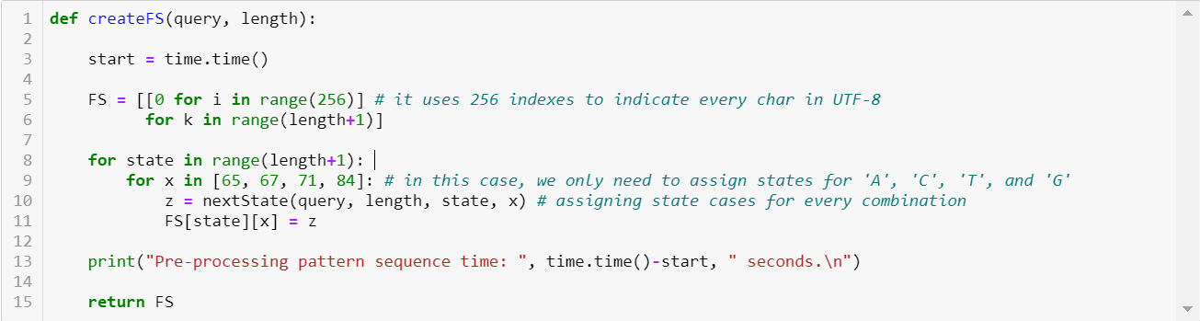
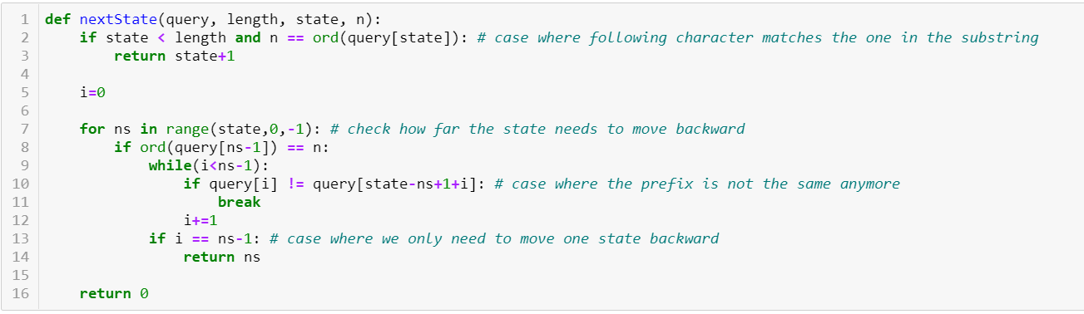
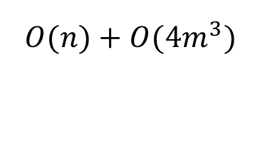
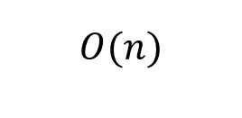
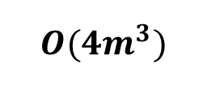
Time Complexity
Pre-processing
$$O({4m}^{3})$$
Overall
$$O(n)$$
$O(n)$ + $O({4m}^{3})$
Searching
Saturn

Slide 21
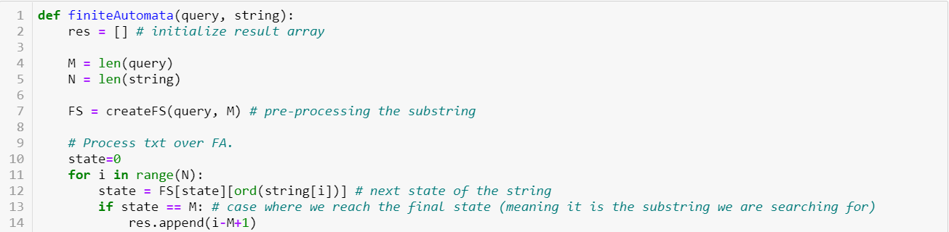
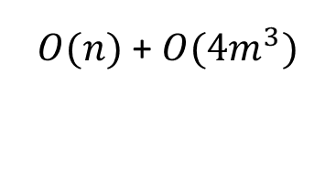
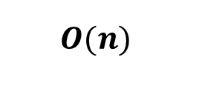
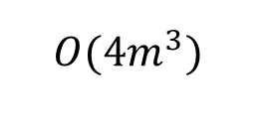
Time Complexity
Pre-processing
$$O({4m}^{3})$$
Overall
$$O(n)$$
$O(n)$ + $O({4m}^{3})$
Searching
Saturn

Slide 22
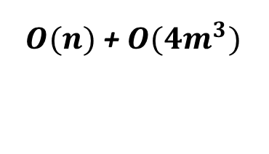
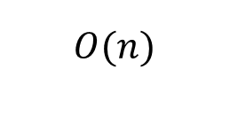
Time Complexity
Pre-processing
$$O({4m}^{3})$$
*m is not significant in most cases
Overall
$$O(n)$$
$O(n)$ + $O({4m}^{3})$
Searching
Saturn

Slide 23
BOYER-MOORE HORSPOOL ALGORITHM

Slide 24
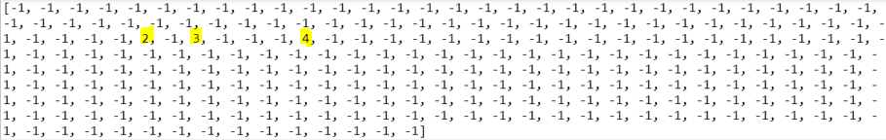
Pre-processing Stage
0 1 2 3 4
A C A C G
Character ‘A’: index 2
Character ‘C’: index 3
Character ‘G’: index 4
Character ‘T’: index -1 (non-existent)
Notes:
Brief explanation: those are the 256 possible characters in UTF-8 encodings. As you can see, almost all are filled with -1 bcs they nvr appear in the substring. However, you can see that A appears last at index 2, C at index 3, and G at index 4.

Slide 25
Searching Stage
Index | 0 | 1 | 2 | 3 | 4 | 5 | 6
DNA sequence | A | C | A | C | A | C | G
Pattern | A | C | A | C | G

Slide 26
Searching Stage
We search from the back!
Index | 0 | 1 | 2 | 3 | 4 | 5 | 6
DNA sequence | A | C | A | C | A | C | G
Pattern | A | C | A | C | G
A mismatch is found at index 4!

Slide 27
Searching Stage
Index | 0 | 1 | 2 | 3 | 4 | 5 | 6
DNA sequence | A | C | A | C | A | C | G
Pattern |  |  | A | C | A | C | G
The next occurrence of ‘A’
The pattern is shifted to the right by 2 indexes.

Slide 28
Searching Stage
Search from the end of substring!
Index | 0 | 1 | 2 | 3 | 4 | 5 | 6
DNA sequence | A | C | A | C | A | C | G
Pattern |  |  | A | C | A | C | G
Characters at index 6 match

Slide 29
Searching Stage
Index | 0 | 1 | 2 | 3 | 4 | 5 | 6
DNA sequence | A | C | A | C | A | C | G
Pattern |  |  | A | C | A | C | G
Index | 0 | 1 | 2 | 3 | 4 | 5 | 6
DNA sequence | A | C | A | C | A | C | G
Pattern |  |  | A | C | A | C | G
Characters at index 5 match

Slide 30
Searching Stage
Index | 0 | 1 | 2 | 3 | 4 | 5 | 6
DNA sequence | A | C | A | C | A | C | G
Pattern |  |  | A | C | A | C | G
Index | 0 | 1 | 2 | 3 | 4 | 5 | 6
DNA sequence | A | C | A | C | A | C | G
Pattern |  |  | A | C | A | C | G
Index | 0 | 1 | 2 | 3 | 4 | 5 | 6
DNA sequence | A | C | A | C | A | C | G
Pattern |  |  | A | C | A | C | G
Characters at index 4 match

Slide 31
Searching Stage
Index | 0 | 1 | 2 | 3 | 4 | 5 | 6
DNA sequence | A | C | A | C | A | C | G
Pattern |  |  | A | C | A | C | G
Characters at index 3 match

Slide 32
Searching Stage
Index | 0 | 1 | 2 | 3 | 4 | 5 | 6
DNA sequence | A | C | A | C | A | C | G
Pattern |  |  | A | C | A | C | G
Characters at index 2 match

Slide 33
Searching Stage
Index | 0 | 1 | 2 | 3 | 4 | 5 | 6
DNA sequence | A | C | A | C | A | C | G
Pattern |  |  | A | C | A | C | G
Everything matches!
Position of the pattern is found!

Slide 34

Time Complexity
Best-case analysis: O(n/m)
Worst-case analysis: O(nm)
Average-case analysis: O(n/4)

Slide 35
Comparisons to Brute Force

Slide 36

Brute Force (Time complexity)
Best-case analysis: O(n)
Worst-case analysis: O(mn)
Average-case analysis: O(m+n)

Slide 37
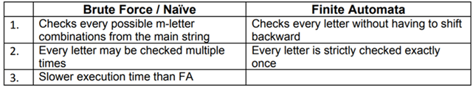
Brute Force vs Finite Automata
E.g. a string input ‘AAAAAAAAAA’ takes longer to execute using Brute Force than FA (2.21s > 0.53s).

Slide 38
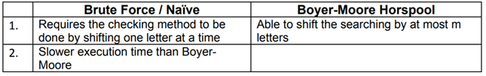
Brute Force vs Boyer-Moore Horspool
E.g. a string input ‘AAAAAAAAAA’ takes longer to execute using Brute Force than Boyre-Moore Horspool (2.21s > 0.26s).

Slide 39
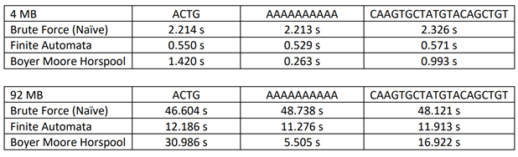
Comparison between the different algorithms (in terms of their time complexities)

Slide 40
Comparisons with Other Algorithms

Slide 41



Why FA and not KMP?
What is KMP?
Knutt-Morris-Pratt Algorithm
(KMP)
Looks for a word within a text string by observing where a mismatch occurs
No mismatch = pattern is found.
Mismatch = window moves forward based on the LPS[]
Notes:
searches for occurrences of a "word" W within a main "text string" S by employing the observation that when a mismatch occurs, the word itself embodies sufficient information to determine where the next match could begin, thus bypassing re-examination of previously matched characters.
What is the lps array =
continuously moving the window forward based on the lps[]

Slide 42
Why FA and not KMP?
FA:
KMP:
Increases or decreases states according to matching of letters in pattern and in sequence Checks all the states Checks if State = Length | Compares each and every character Check the lps[] array Checks if State = Length

Slide 43

Why FA and not KMP?
Evaluation:
Input pattern is long, but the main string is short: KMP > FA
Both input pattern and the main sequence are long: FA > KMP
Why? : FA will have lesser comparisons to make
Efficiencies of both KMP and FA are fairly consistent

Slide 44


Why FA and Boyer-Moore-Horspool and not Rabin Karp?
What is Rabin Karp?
=
Uses hashtag to find to find an exact match of a pattern string in a text
Hash function: Converts a string into a numeric value,called hash value. E.g. hash(hello) = 5
Performing comparison only at positions that pass the index check
Notes:
A hash function is a function which converts every string into a numeric value, called its hash value; for example, we might have hash("hello")=5
Several string-matching algorithms, like the Knuth–Morris–Pratt algorithm and the Boyer–Moore string-search algorithm, reduce the worst-case time for string matching by extracting more information from each mismatch, allowing them to skip over positions of the text that are guaranteed not to match the pattern. The Rabin–Karp algorithm instead achieves its speedup by using the hash function to quickly perform an approximate check for each position, and then only performing an exact comparison at the positions that pass this approximate check.
The Rabin–Karp algorithm proceeds by computing, at each position of the text, the hash value of a string starting at that position with the same length as the pattern. If this hash value equals the hash value of the pattern, it performs a full comparison at that position.

Slide 45
Why FA and Boyer-Moore-Horspool and not Rabin Karp?
FA:
Rabin Karp:
Boyer-Moore:
Increases or decreases stated according to matching of letters in pattern and in sequence Checks all the states Checks if State = Length | Calculates hash value of pattern of length m Calculates hash value of all substrings in the sequence that are of length m Slides the pattern one by one against the sequence, but instead checks the hash value of pattern with hash value of current substring | Uses bad character heuristics Finds mismatch between pattern and sequence Aligns last matching letter to mismatched letter Shift the entire pattern forward if last letter of pattern does not match the letter in the sequence

Slide 46
Why FA and Boyer-Moore-Horspool and not Rabin Karp?
Evaluation:
Rabin Karp will be slow when the pattern to be found in the sequence is very long.
It will in fact be no better than the Brute Force/Naive algorithm.
Notes:
For example, if you're looking for a string of 10⁵ copies of the letter a in text string consisting of 10⁹copies of the letter a with Rabin-Karp, then there will be lots of spots where the pattern string appears, and each will require a linear scan. This can also lead to a runtime of Ω((m + n - 1)n).

Slide 47
Why Boyer-Moore Horspool and not just Boyer-Moore?
Boyer-Moore Horspool:
Boyer-Moore:
Bad Character Heuristics | Both Bad Character Heuristics and Good Suffix Heuristics
Does not need to check every single character of the sequence as it can skip some using the Bad Match table. | Unable to skip several characters as once as each suffix also has to be matched and checked
Able to skip a lot of characters as the pattern being searched becomes longer.
Pre-processing is faster resulting in the overall time complexity to be faster. | Preprocessing takes longer as both bad character and good suffix heuristics is applied to the pattern.
Internal loop of coding is simpler | Writing and readability of the code becomes more complex with the addition of good suffix heuristics
Notes:
Using horspool when we have a long input, when we have skip a lot of characters
Pre-processing faster
The Boyer-Moore-Horspool algorithm only uses bad character heuristic while Boyer-Moore algorithm uses both bad character heuristics and good suffix heuristics
algorithm gets faster as the substring being searched for becomes longer. This is because with each unsuccessful attempt to find a match between the substring and the string, the algorithm uses the Bad Match table to rule out positions where the substring cannot match.
n the worst-case the performance of the Boyer-Moore-Horspool algorithm is O(mn), where m is the length of the substring and n is the length of the string.
The average time is O(n). In the best case, the performance is sub-linear, and is, in fact, identical to Boyer-Moore original implementation.

Slide 48


Why Boyer-Moore Horspool and not just Boyer-Moore?
Evaluation:
Implementation of both algorithms is fairly similar.
Boyer-Moore Horspool:
Easier to code
Works better with longer inputs
Faster pre-processing speed.

Slide 49
Final Judgement

Slide 50


When to Use Each Algorithm?
Finite Automata (FA):
General Searching Algorithm
Consistent Time Complexity
Notes:
Finite Automata (similar to the Knuth-Morris-Pratt algorithm) is suitable for a general pattern searching condition. It has a stable time complexity that does not differ regardless of given main and substrings.

Slide 51

When to Use Each Algorithm?
Boyer-Moore Horspool:
Few possible types of characters in input pattern but a lot of types in main string
Example:
Input string = ‘AAAAAA’
Main string = ‘ABCDEFGHIJKLMNOPQRSTU’
Notes:
Boyer Moore Horspool algorithm, on the other hand, is suitable on a search whose substring only consists of very few types of characters. Only in this case, we would be able to skip a lot of letters that are not included in the substring. We must be extremely careful as this algorithm would run at a similar time to Brute Force (Naïve) algorithm if it is used for its worst-case as explained above.
I,e, the total number of characters possible in the sequence must be as low as possible for this algorithm to work best

Slide 52

Thanks!
Any Questions?

